Slide 1

Meta-Transformer: Navigating Multimodal Landscape
As the field of AI continues to advance, the integration of multimodal learning has become increasingly crucial. The Meta-Transformer offers a unified framework that stands at the forefront of AI advancements, providing a seamless approach to processing diverse data. This presentation will delve into the theoretical foundations, architecture, applications, and future directions of the Meta-Transformer framework, showcasing its potential to revolutionize the AI landscape.

Slide 2

Introduction
Multimodal learning is paramount in capturing the complexities of real-world data. The Meta-Transformer represents a groundbreaking unified framework that is designed to address the holistic integration of data from diverse sources. This section will provide a brief yet comprehensive overview of the significance of multimodal learning and introduce the Meta-Transformer framework as a pivotal solution in this space.

Slide 3
Theoretical Foundations
1
Transformer Models
Transformer models, initially designed for natural language processing (NLP), represent a breakthrough in neural network architecture. Their distinguishing feature is the self-attention mechanism, allowing the model to weigh different parts of a sequence dynamically. This innovation enhances the model's ability to capture contextual information efficiently, making transformers versatile across various domains, including Meta-Transformer's handling of multimodal data.
2
Self-Attention Mechanisms
The self-attention mechanism is a pivotal element in transformer models and Meta-Transformer. It enables the model to assign varying levels of importance to different elements within a sequence. In Meta-Transformer, this mechanism is crucial for processing diverse data types effectively. By adaptively focusing on different aspects of the input, self-attention facilitates the model's understanding of intricate relationships within and between modalities.
3
Multimodal Learning
Multimodal learning involves integrating information from various sources like text, images, and tabular data to achieve a more comprehensive understanding of complex relationships. The theoretical foundations of multimodal learning guide Meta-Transformer in unifying different modalities seamlessly. This approach ensures cohesive information processing, allowing the model to navigate and comprehend the nuances present in diverse data types effectively.

Slide 4
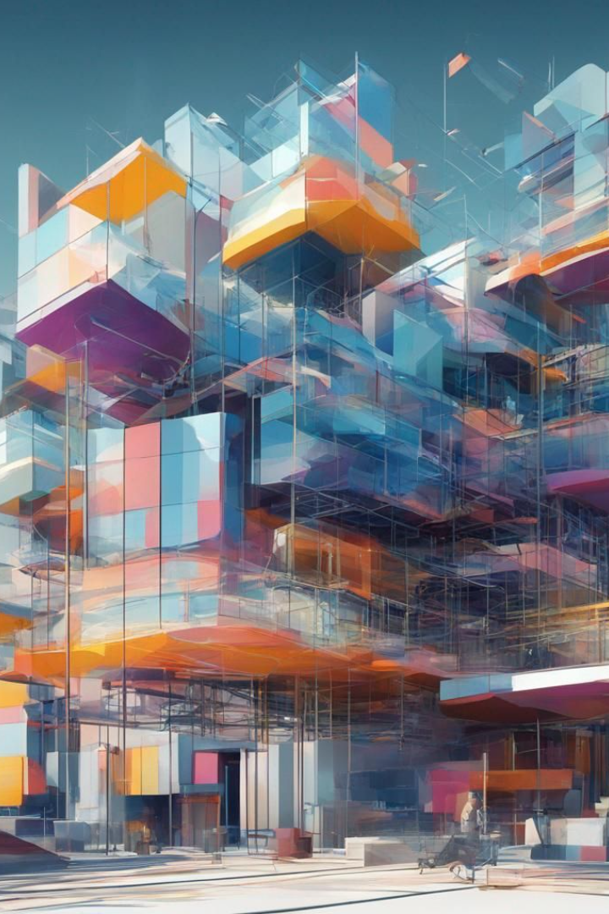
Meta-Transformer Architecture
The Meta-Transformer introduces a revolutionary architecture that extends the traditional transformer's capabilities to handle multimodal data. This section will provide an in-depth exploration of how the Meta-Transformer efficiently processes different data types, including text and tabular data. It will highlight the architectural innovations that enable seamless integration of diverse modalities.

Slide 5
Unified Framework
Streamlined Processing
Simplified Architecture
Real-World Applicability
The unified framework of Meta-Transformer contributes to its real-world applicability. In practical scenarios where datasets encompass a mix of text, images, and tabular information, having a model capable of seamlessly handling these modalities is paramount. Meta-Transformer's architecture allows it to flexibly adapt to diverse data types, making it a valuable asset in various domains such as healthcare, natural language understanding, and image recognition.
Meta-Transformer introduces streamlined processing as a fundamental characteristic within its unified framework. By seamlessly integrating diverse modalities, such as text, images, and tabular data, the model ensures efficient and cohesive information processing. This streamlining allows Meta-Transformer to navigate the complexities of multimodal data seamlessly, enhancing its adaptability and versatility.
A key feature of Meta-Transformer is its simplified architecture resulting from the unification of modalities. Instead of developing separate models for each data type, Meta-Transformer integrates them into a singular, coherent structure. This simplification not only streamlines the training process but also facilitates effective leveraging of synergies between different modalities. The model's architecture is designed for clarity, efficiency, and improved overall performance.

Slide 6
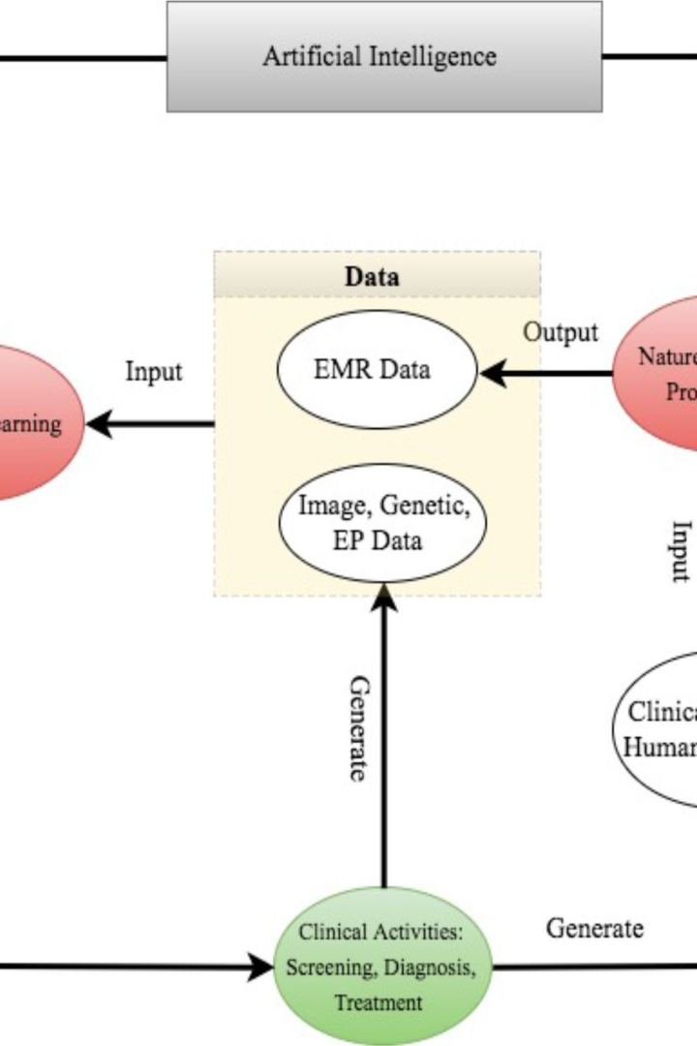
Applications and Use Cases
1. Text Classification with Tabular Data:
Enhanced Understanding: Meta-Transformer excels in text classification by seamlessly integrating tabular data, providing a richer contextual understanding beyond text.
Performance Boost: The fusion of text and tabular data enhances predictive performance, especially in scenarios where text alone may lack context.
Example: In e-commerce, Meta-Transformer analyzes customer reviews along with product categories and ratings for more accurate sentiment analysis.
2. Healthcare and Biomedical Research:
Advancing Medical Data Analysis: Meta-Transformer proves indispensable in healthcare, adeptly processing multimodal medical data for improved diagnostics.
Personalized Medicine: The framework supports personalized medicine by comprehensively understanding patient data from diverse sources.
Example: In healthcare, Meta-Transformer analyzes patient records, medical images, and tabular data to enhance decision-making, particularly in personalized treatment plans.

Slide 7

Research Contributions
1
Unified Processing
2
Improved Performance
An exploration of how the Meta-Transformer's unified processing eliminates the need for modality-specific models.
A detailed discussion on how the Meta-Transformer enhances text-based tasks with the integration of tabular data, resulting in improved performance.
3
Theoretical Foundations
An analysis of the theoretical foundation, implementation insights, and practical significance of the Meta-Transformer's contributions to the field.

Slide 8
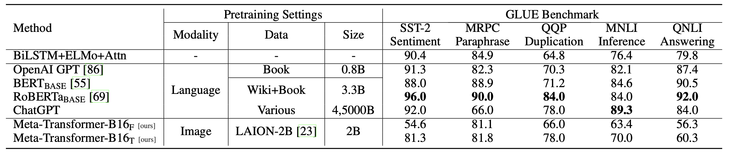
Results
Quantitative results pertaining to benchmarking accuracy enhancement in text classification and the revolutionary impact on medical data analysis in healthcare applications will be presented in this section. Furthermore, a comparison to baseline models will illustrate the transformative potential of the Meta-Transformer framework.

Slide 9
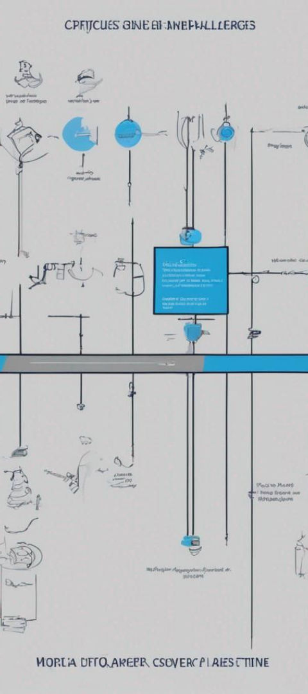
Critiques and Challenges
1
Computational Complexity
Challenge: Processing diverse modalities, such as text and tabular data, may increase computational demands.
Potential Impact: Heightened complexity could pose challenges, particularly in real-time applications requiring swift decision-making.
Path Forward: Ongoing optimization strategies and algorithmic enhancements are crucial to balance model performance and computational efficiency.
2
Interpretable Fusion
Challenge: Achieving interpretable fusion of information from different modalities remains a research challenge.
Importance: Model transparency and user trust hinge on understanding how Meta-Transformer fuses information.
Research Focus: Ongoing efforts involve exploring techniques for unraveling the intricacies of fusion mechanisms at the modal level.

Slide 10
Future Directions and Conclusion
1. Efficient Attention Mechanisms:
Focus: Explore and develop more efficient attention mechanisms.
Rationale: The intricate nature of diverse modalities requires discerning and prioritizing relevant information effectively.
Techniques: Consider sparse attention or adaptive attention weights to optimize computational efficiency while maintaining nuanced relationships.
2. Expandability and Interpretability:
Importance: Crucial for sensitive domains like healthcare and legal contexts.
Methods: Employ attention visualization, layer-wise relevance propagation, or integrated gradients for transparent insights.
Understanding: Deepen the understanding of processes for user trust, regulatory compliance, and ethical deployment.
Meta-Transformer: A Beacon of Promise
Innovation: Extends traditional transformer capabilities for unified multimodal learning.
Versatility: Seamlessly integrates text and tabular information, demonstrating tangible improvements in accuracy.
Challenges: Computational complexity and interpretable fusion persist but do not overshadow robust theoretical foundations and practical contributions.
Future: The fusion of efficient attention mechanisms and enhanced explanability sets the stage for continued evolution and transformative impact.

